Slide 1
HA Resource Hub Submission Form
Resource Title: Finding Out About WW2 | Age Range: Upper KS2
Author name and email contact: Alf Wilkinson sue.alf@btopenworld.com | Resource Details: One PowerPoint
Necessary prior learning to complete this: None | What does it lead to next? Key Stage 3 study of WWII Has links to Geography in places where events took place
Explanation: How should this resource be used? As an introductory research project into an overview of WW2 across the world. By clicking on the timeline one is led to each key event and ‘to find out’ questions. A short key questions slide at the start aims to pull pupils’ thinking together. If possible, pupils can also print and annotate a world map to show some of the events of the war across the world. Could be followed up with more in-depth work on any of the topics covered. Other events left out could be added. Model could be used for any KSt2 topic. NB – The PowerPoint is editable and different events can be substituted by teachers if desired.

Slide 2
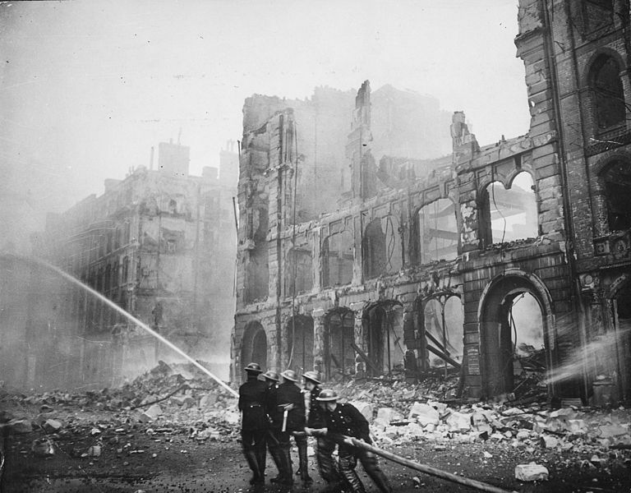
Finding out about World War Two Across the World
Notes:
Wikipedia image in the public domain..........

Slide 3
some key questions to think about...........
which, in your opinion, was the worst year of the war? Why?
which, in your opinion, was the best year of the war? Why?
which, in your opinion, was the most significant event of the war?
Some historians say that World War Two was Hitler’s War. Do you agree?
A couple of websites to help get you going.....................
BBC Class Clips:
www.bbc.co.uk/teach/class-clips-video/history-ks2-world-war-two/zjnyscw
evacuation from Cardiff:
www.peoplescollection.wales/collections/384105
WW2 photos: National Archives [of America]
www.archives.gov/research/military/ww2/photos
WW2: www.dkfindout.com/uk/history/world-war-ii/

Slide 4
Finding out about World War Two.
20
14
1
3
4
8
9
13
17
2
15
1939
5
7
1945
18
11
6
10
21
16
12
19
Click on each number to explore one aspect of WW2

Slide 5
1. Evacuation
introduced in September 1939
move children – and mums with young children – out of cities
many didn’t know where they were going
whole school evacuated together
To find out:
where were children evacuated to?
were all children happy when they were evacuated?
was evacuation a success?
Click to continue

Slide 6
2. Britain declares war on Germany
3rd September Britain declared war on Germany
Adolf had spent the last 8 years trying to tear up the Treaty of Versailles that ended WW1 and make Germany great again
Finally, Chamberlain, Britain’s Prime Minister, had had enough
To find out:
Why did Britain finally declare war on Germany?
what happened when war was declared?
Click to continue

Slide 7
3. Rationing introduced
On the 8th January 1940 rationing was introduced – bacon, sugar and butter were rationed
as the war went on, more and more foods and things like clothes and petrol were rationed
some foods were never rationed during the war
To find out:
why was rationing introduced during the war?
how did people try to add to their rations?
was rationing a success?
Click to continue

Slide 8
4. Dunkirk
The British Army moved to France and Belgium to fight the Germans
At first, nothing happened
In April and May, the Germans attacked, using the new tactic of ‘Blitzkrieg.’
The British Army was forced back to Dunkirk, where over 300,000 British and French troops were evacuated back to Britain
To find out:
what was ‘blitzkrieg?’ why was it so successful?
was Dunkirk a victory for the British or a defeat?
who became Britain’s Prime Minister in May 1940? How did he change attitudes to the war?
click to continue

Slide 9
5. The Battle of Britain
to defeat Britain, Hitler had to invade. He could only do this if he defeated the Royal Navy and the RAF
in July 1940 he began his attempt to destroy the RAF
Spitfires and Hurricanes (types of fighter planes) fought the Luftwaffe (German air force) above the skies of South East England. This was called the Battle of Britain.
what advantages did the RAF have in the Battle of Britain?
what disadvantages did it have?
what change in tactics did the Germans make in September that ‘saved’ the RAF from defeat?
click to continue

Slide 10
6. The Blitz
from September onwards, the Luftwaffe bombed British towns and cities
they thought Britain would give in and ask for peace
factories and docks, as well as people, were targets
over 10,000 people were killed by bombing in London alone
To find out:
what type of bombs were dropped by the Germans?
what did people do to keep safe?
how effective do you think the bombing was?
why did the bombing eventually stop?
click to continue

Slide 11
7. The Battle of the Atlantic
at the start of the war, over 60% of Britain’s food and raw materials was imported
nearly all had to cross the Atlantic Ocean
German U-Boats tried to sink as many British ships as they could, hoping to starve Britain into surrender
Winston Churchill said, after the war, ‘the only thing that worried me was the Battle of the Atlantic.’
To find out:
why were U-Boats so difficult to destroy?
what new weapons did the British invent to protect their ships crossing the Atlantic?
when do you think the Battle of the Atlantic was won?
click to continue

Slide 12
8. ‘Barbarossa’ – the invasion of Russia
Hitler wanted ‘Lebensraum’ – living space – for Germans in the east
He also hated communists – Russia was a communist country
in June 1941 Hitler invaded Russia. Russia had wheat, oil, iron ore that Germany needed for its war effort
By December German troops were nearly in Moscow and Leningrad
To Find Out:
to begin with, it looked like the German invasion was
successful. Why was this?
What stopped the German advance?
What part did the partisans play in defeating the
Germans?
click to continue

Slide 13
9. Pearl Harbour
on December 7th 1941, Japan attacked the US naval base at Pearl
Harbour, in the Pacific Ocean
the Americans were taken completely by surprise
the Japanese were attempting to have an empire in the East, and
capture the oil and other materials they needed. They had sided with Hitler’s Germany in the war.
Japan treated any prisoners – military and civilian – really badly
Germany also declared war on the USA
To Find Out:
how did the Japanese attack Pearl Harbour? What part
did aircraft carriers play?
was the attack a success?
by early 1942, how much of the Pacific did Japan control?
click to continue

Slide 14
10. The Battle of Midway Island
in June 1942 the Americans beat the Japanese for the first time,
at Midway Island
it was the first time two fleets fought each other without coming
into contact – the fighting was done by aeroplanes
after Midway, the Americans and their allies were able to slowly
force back the Japanese troops and navy
To Find Out:
where is Midway Island? Why was it important?
how did the Americans win the battle?
why was it important for the Americans and their
Allies to have control of the sea?
click to continue

Slide 15
11. The Battle of El Alamein
Egypt controlled the route to India, and the oil of the Middle East
German and Italian troops were within 40 miles of the Suez Canal
in August 1942 the 8th Army launched an attack at El Alamein
slowly the Germans were driven back – for the first time Britain
and its Allies had defeated the Germans. For the first time since
Dunkirk, church bells were rung in Britain
To Find Out:
Where is the Suez Canal?
What was it like fighting in the desert?
After several defeats in North Africa, how did the
8th Army manage to defeat the Germans and Italians?
Where did the Allies attack next? Why?
click to continue

Slide 16
12. The Battle of Stalingrad
Stalingrad was a major Russian city, named after the ruler of Russia, Josef Stalin
by August 1942 the German army was on the outskirts of the city
Stalin ordered it to be defended at all costs
In December 1942 a fresh Russian army surrounded the Germans
Eventually the Germans had to surrender
Stalingrad was the first major defeat for Germany in Russia
To Find Out:
How many people died defending Stalingrad?
What was the fighting like in the city?
How did Hitler try to supply his surrounded army? Why
didn’t it work?
click to continue

Slide 17
13. The Battle of Kursk.
in July and August 1943 the largest tank battle ever fought took
place at Kursk, in Russia
10,000 Russian and 5,500 German tanks took part
The Germans lost, despite destroying more Russian tanks
After that, the Germans were always on the retreat in the East
To Find Out:
Why was the battle fought at Kursk?
Which side had the better tanks?
what was the significance of the battle?
click to continue

Slide 18
14. Hamburg
‘Bomber’ Harris was convinced Britain could win the war by bombing
Germany
from 1942 the RAF and USAAF bombed German industry and cities
day and night
24th July 1943 for 8 days and 7 nights they bombed Hamburg
over 37,000 Germans were killed, and the city badly damaged
it was the heaviest raid on a German city of the war
To Find Out:
what % of RAF bomber crews died attacking Germany?
what damage was caused to Hamburg?
did bombing ‘win the war?’
find out what happened to Dresden in February 1945
click to continue

Slide 19
15. D-Day
Earlier in the war, Hitler had advanced and captured France. For much of the war, France was occupied and controlled by Germany. On the 6th June 1944 the Allies landed in France
it had taken two years to plan the invasion of Europe
Hitler knew if the invasion succeeded the war would be lost
over 3 million troops were ready to attack Europe
by 24th August the Allies had captured Paris
To Find Out:
how did the Allies deceive the Germans about where
the invasion would be?
how difficult was it to get so many troops and so
much equipment across the English Channel?
Some German officers thought the war was now lost and tried to kill Hitler. Find out about the ‘Bomb Plot.’
click to continue

Slide 20
17. The Battle of Iwo Jima
Iwo Jima was an important island on the way to Japan
it could be used to bomb Japan
the Japanese were determined to defend it. 21,000
Japanese troops dug in to fight the Americans
over 1 in 3 of the American troops attacking it were killed or
wounded
it took over one month to capture the island
To Find Out:
how far from Japan is Iwo Jima?
why were the Japanese so determined to defend it?
what was the fighting like?
what was the significance of Iwo Jima?
click to continue

Slide 21
18. The Battle for Berlin
by January 1945 the Russians were near Germany in the East
Britain and its Allies were approaching Germany from the West
in April the fighting reached Berlin
old men and young boys were given weapons and told to defend Berlin
Hitler killed himself in his bunker
To Find Out:
what happened at the River Elbe on 25th April 1945?
why was this so important?
why did the Germans still carry on fighting?
when do you think the Germans lost the war?
click to continue

Slide 22
19. V-E Day
VE day [Victory in Europe] was on 8th May in the West, and 9th May
in Russia
Hitler was dead, and the Nazis were defeated
huge street parties were held all across Europe to celebrate
there was still Japan to defeat......
To Find Out:
as Hitler was dead, who led the surrender of Germany?
what was life in Germany like in May 1945?
what happened to Germany as a result of the war?
click to continue

Slide 23
20. Hiroshima
Hiroshima was a major city in Japan
Allied leaders thought to invade Japan would take another year and
cost the lives of 1 million Allied troops
President Truman took the decision to drop an atomic bomb on
Hiroshima
when Japan refused to surrender another bomb was dropped on
Nagasaki.
Japan surrendered
To Find Out:
how powerful was the atomic bomb?
how many people were killed by the two atomic bombs?
was Truman right to drop the bomb on Japan?
click to continue

Slide 24
21. V-J Day
on 14th August 1945 Japan surrendered. World War Two was over
15th August has been known as V-J Day ever since
some Japanese soldiers refused to surrender and continued to
fight in the jungles of South East Asia
finally the world was at peace
To Find Out:
what happened to the Japanese at the end of the war?
were the Japanese punished as much as the Germans?
did the defeat of Japan bring peace to the world?
click to continue

Slide 25
22. Your WWII Map
Now that you have found out more about some of the events and places where the Second World War was fought, print off a map of the world if you can and find and mark all the places that you have learned about.
sue.alf@btopenworld.com

