Slide 1
Enquiry 7 overview: An unfinished war Why was there no peace in Korea?
Lesson 7.1
Why did the Korean War drag on until 1953?
Lesson 7.2
How did the war leave an enduring impact on the Korean people?
Lesson 7.3
Could a ‘hot war’ have erupted again in Korea during the Cold War?
Lesson 7.4
Why has there not been peace in Korea even after the end of the Cold War?

Slide 2
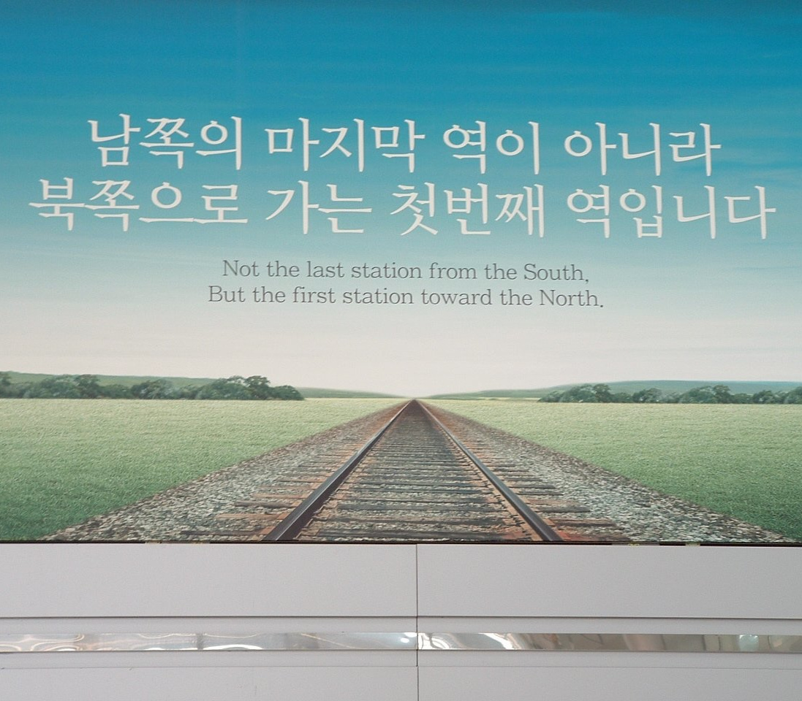
Lesson 7.4: Why has there not been peace in Korea even after the end of the Cold War?
Starter
What do you think are the main obstacles to peace on the Korean Peninsula?
Notes:
Image: © Author/Guy Birks

Slide 3
Lesson 7.4 Overview and aims
Lesson 7.4
Why has there not been peace in Korea even after the end of the Cold War?
In this lesson you will:
Identify and explain the main reasons why there has been no peace treaty in Korea after the end of the Cold War.
Debate what may be the most effective means by which to reduce tensions on the Korean Peninsula and move towards a permanent peace.

Slide 4
Why has there been no peace treaty?
Activity 1
Around the room you will find sources and information about the main issues that have shaped relations on the Korean Peninsula from 1991 to the present. Some have improved relations; some have harmed them.
Analyse the information and sources using a table like this.
Factor/event/ development | Harming relations How have these events made tensions worse? Who may be at fault? e.g. North Korea/USA | How has the factor improved relations? | Extension Are there issues of reliability related to the information or sources?

Slide 5
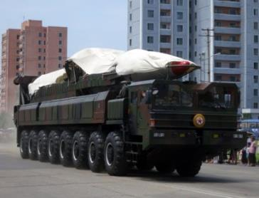
Factor 1: North Korea’s nuclear weapons programme, pre-2015
FACTOR PACK
1986: Research nuclear reactor in Yongbyon is operational.
1993: International Atomic Energy Agency accuses North Korea of violating the Nuclear Non-Proliferation Treaty and demands inspectors be given access to nuclear waste storage sites. North Korea threatens to quit Treaty.
1998: North Korea fires its first long-range missile.
2003: North Korea withdraws from Nuclear Non-Proliferation Treaty (NPT).
2014: March – North Korea test-fires two medium-range Rodong ballistic missiles for the first time since 2009, in violation of UN resolutions and just hours after the US, South Korea and Japan met in the Netherlands for talks.
2015: September – North Korea confirms that it has put its Yongbyon nuclear plant – mothballed in 2007 – back into operation.
2015: December – US imposes new sanctions on North Korea over weapons proliferation, targeting the army’s Strategic Rocket Force, banks and shipping companies.
Notes:
Image: CC BY 2.0/Stefan Krasowski/Wikimedia, https://commons.wikimedia.org/w/index.php?curid=58241477

Slide 6
FACTOR PACK
Songun = military first
Until Kim Jong Un’s altered emphasis in favour of economic development, North Korean policy has been directed by Songun – ‘military first’ – prioritising military expenditure, resource allocation and the primacy of the military in the affairs of state. Around 25% of GDP is still spent on the military.
Source 1A: Extract from the website of The Heritage Foundation. This is a conservative-leaning political lobbying group in the USA
The U.S. Intelligence Community has ‘long assessed that Pyongyang’s nuclear capabilities are intended for deterrence, international prestige, and coercive diplomacy.’ From Pyongyang’s perspective, having nuclear weapons makes eminent sense since it concurrently fulfils several long-standing foreign policy objectives:
Regime survival, by deterring allied attacks or retaliations in response to North Korean provocations;
Source of national pride, by achieving equal status with the United States;
Domestic legitimacy and international prestige for the leadership;
Tremendous military power, overcoming deficiencies in conventional forces to achieve reunification;
Formidable leverage for coercive diplomacy, to wrest concessions and benefits;
Undermining of the U.S.–South Korean alliance, by sowing doubt that Washington would come to Seoul’s defense once the American homeland is under nuclear threat.
Notes:
www.heritage.org/insider/summer-2018-insider/why-does-north-korea-want-nukes

Slide 7
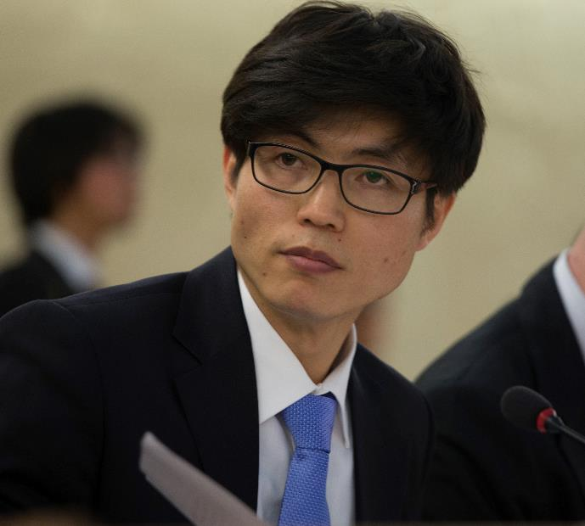
FACTOR PACK
Factor 2: Defectors
Example 1: Song Byeok Song Byeok was a propaganda artist. His father drowned on their first attempt to cross the Tumen river, in 2000. When the artist finally left North Korea in 2001, he brought photos of his family with him.
Source 2A ‘I was devastated. He was going under the water and couldn’t get out. I rushed up to the [North Korean] border guards and asked them to save him but they just said why did I come out, why didn’t I die too. They handcuffed me and took me away. It was 28 August.
I was tortured by the bowibu [state security] in Hoeryong, then jailed for four months in Chongjin prison camp.
But after I was released from the camp I felt like I needed to survive and carry on living. Right before I tried to defect again, I went back home and grabbed my family photos. Even if I died trying, I thought, at least I would have this picture with me.’
Notes:
Image: US Mission Geneva/Eric Bridiers – www.flickr.com/photos/us-mission/13220636834; public domain – https://commons.wikimedia.org/w/index.php?curid=31835813.
Defectors’ accounts: www.independent.co.uk/news/world/north-korea-escaped-south-seoul-stories-photos-a8310456.html

Slide 8
FACTOR PACK
Example 2: Kim Ryon Hui
Kim Ryon Hui, 49, is from Pyongyang. She says that she never wanted to defect. In 2011, she says, a broker helped her go to China for treatment on her liver. But the broker tricked her, she said, and she ended up in South Korea. She is campaigning to return, which Seoul says would be against the law.
Source 2B: ‘I miss my parents even more than I miss my daughter. They’re everything to me. For the first few years, I couldn’t even breathe properly when I thought of them. My daughter’s name is Ri Ryon Gum. She was born on 15 February 1993. I don’t want her to live out her life with me here.’
Source 2C: Comment by Jiyoung (Jay) Song, senior lecturer in Korean studies at the Asia Institute of the University of Melbourne, Australia
‘While there is no doubt the North Korean regime has committed serious human rights abuses, there are questions to be asked about how heavily outsiders should rely on defectors’ testimonies as credible evidence.
Cash payments in return for interviews with North Korean refugees have been standard practice in the field for years. This practice also drives the demand for “saleable stories”: the more exclusive, shocking or emotional, the higher the fee.
But many refugees say they feel pressured for defector stories. Ahn Myung-chol, a former prison guard at Camp 22, said people liked shocking stories and these so-called “defector-activists” were merely responding to this desire. Chong Kwang-il, a former prisoner at Camp 15, said the fame brought by media exposure trapped them, forcing them to reproduce a certain narrative.’
Notes:
Source 2C: www.much.go.kr/en/user/contentView.do?pageIndex=11&fid=04&cid=02&sub=01&page=01&searchRelicclsfcd=&searchAgecd=&searchDatatycd=&searchOrgFormcd=&collectionId=186&idnbr=2014003405.

Slide 9
FACTOR PACK
Factor 3: North Korea’s human rights record
Source 3A: From an article by the Reuters news agency, 18 December 2019. News agencies research stories and then sell them to other organisations such as newspapers or TV networks
The United Nations General Assembly on Wednesday condemned ‘the long-standing and ongoing systematic, widespread and gross violations of human rights in and by’ North Korea in an annual resolution that Pyongyang’s U.N. envoy rejected.
The resolution, sponsored by dozens of countries including the United States, was adopted by the 193-member General Assembly without a vote. Such resolutions are non-binding but can carry political weight.
North Korea’s U.N. Ambassador Kim Song told the General Assembly that the resolution has ‘nothing to do with the genuine promotion and protection of human rights, as it is an impure product of political plots by hostile forces that seek to tarnish the dignity and image of the DPRK and overthrow our social system.’
Notes:
Source 3A: www.reuters.com/article/us-northkorea-rights-un/un-condemns-north-korea-rights-abuses-pyongyang-rejects-resolution-idUSKBN1YM2J8 (18 December 2019)

Slide 10
FACTOR PACK
Source 3B: Extract from an article in the American magazine Foreign Policy.com, December 2019. The magazine is owned by the liberal-leaning Washington Post newspaper
The White House has killed off plans to convene a meeting of the United Nations Security Council to spotlight atrocities by North Korea, according to several diplomatic sources.
The move signaled a desire by U.S. President Donald Trump to salvage a faltering two-year diplomatic effort to convince North Korea to abandon its nuclear weapons program and try to strike a deal with North Korean leader Kim Jong Un before the 2020 U.S. presidential election.
The Trump administration supported a council meeting on North Korea’s human rights record in 2017 but did not in 2018, citing what it said was a lack of support in the council.
‘Once again, the U.S. has prevented the U.N. Security Council from scrutinizing North Korea’s abysmal human rights record, apparently because of President Trump’s special relationship with Kim Jong Un,’ said Louis Charbonneau, the U.N. director for Human Rights Watch.
‘By blocking this meeting, which was set to go ahead on Human Rights Day tomorrow, the Trump administration is sending a message to Kim that the U.S. no long considers arbitrary detention, starvation, torture, summary executions, sexual violence and other crimes again the North Korean people a priority,’ Charbonneau added. ‘North Korea and many other abusive governments can now rest assured that they have little to fear from the Trump administration when it comes to human rights.’
Notes:
Source 3B: https://foreignpolicy.com/2019/12/09/white-house-blocks-un-meeting-north-korea-atrocities-trump-kim

Slide 11
Factor 4: US–Republic of Korea wargames
FACTOR PACK
The United States has had a military presence in South Korea for decades, which it and South Korea have long maintained is necessary for defence – and as a deterrent against North Korean aggression.
North Korea and China see the presence of US troops in South Korea as a threat and an affront. China has grown especially concerned by the US placement of a new anti-ballistic missile system, THAAD, in South Korea.

Slide 12
FACTOR PACK
Source 4: Extract from an article on CNBC.com, August 2017. CNBC is an American pay-TV business news channel owned by the US TV network NBC
The drills, which began in the 1970s and will involve 17,500 American troops and 50,000 South Korean soldiers this year, consist mainly of computer simulations aimed at honing joint-decision making and planning and improving command operations.
Impoverished North Korea hates the drills in part because it must frequently respond with its own expensive displays of military might.
Shortly after the drills, the North carried out its fifth and biggest nuclear test, which it claimed was of a ‘standardized’ warhead that could fit on a variety of its rockets.
South Korea’s Kyunghyang Shinmun newspaper said in an Aug. 11 editorial that the allies could gain a bargaining chip in efforts to persuade the North into meaningful nuclear talks by halting or scaling down the joint drills.
These arguments might not win over South Korean conservatives whose main fear is that a fully functional ICBM in Pyongyang would eventually force the United States to consider a peace treaty with the North and also the removal of the tens of thousands of American soldiers stationed in South Korea.
Some conservatives want more strength, however, and are calling for the United States to bring back the tactical nuclear weapons that were withdrawn from the South in the 1990s.
Notes:
Source 4: www.cnbc.com/2017/08/20/us-south-korea-war-games-heres-how-north-korea-might-respond.html

Slide 13
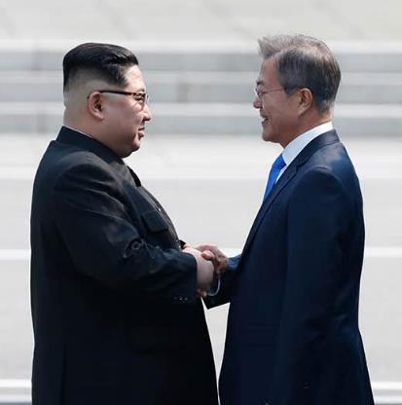
FACTOR PACK
Factor 5: ‘The Sunshine policy’
The idea behind the policy was that persuasion was better than force, and that dialogue and economic and cultural exchange would help to change the North and foster peace between the two Koreas.
2000: June – Landmark inter-Korean summit in Pyongyang between Kim Jong-il and South Korean President Kim Dae-jung. It paves the way for reopening border liaison offices and for family reunions. The South also grants amnesty to over 3,500 North Korean prisoners.
2004: Kaesong Industrial complex launched. South Korean companies able to use North Korean labour. One intention is to enable the gradual reform of the North Korean economy.
2007: July – North Korea shuts its Yongbyon reactor after receiving 50,000 tons of heavy fuel oil as part of an aid package.
2007: August – South Korea announces that it will send nearly $50m aid to the North after Pyongyang makes rare appeal for flood relief.
2007: October – Second inter-Korean summit held in Pyongyang. President Roh Moo-hyun becomes the first South Korean leader to walk across the Demilitarized Zone separating North and South.
2008: March – North–South relations deteriorate sharply after new South Korean President Lee Myung-bak promises to take a harder line on North Korea. A North Korean soldier shoots and kills a South Korean tourist who strayed into an off-limits area in the North’s Mount Kumgang resort in 2008.
Notes:
Extract: www.reuters.com/article/uk-northkorea-usa-sunshinepolicy/vindication-architects-of-south-koreas-sunshine-policy-on-north-say-its-paying-off-idUKKBN1J60PJ
Image: KOGL Type 1/Cheongwadae/Blue House https://commons.wikimedia.org/w/index.php?curid=68600876

Slide 14
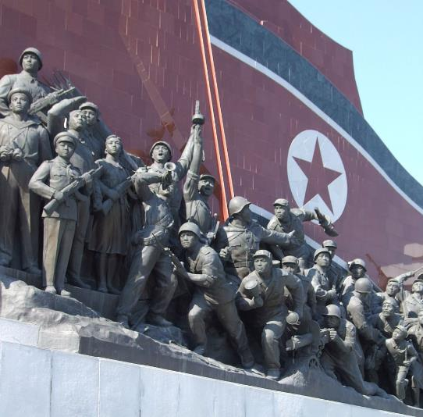
FACTOR PACK
Factor 6: Bush – ‘Axis of evil’ and sanctions
In January 2002, US President George W Bush labelled North Korea, Iraq and Iran an ‘axis of evil’ for continuing to build ‘weapons of mass destruction’. He vowed that no members of this triple axis would be allowed to obtain WMD.
However, Bush was unable to prevent North Korea from doing so. It tested its first weapon in 2006 and later developed a delivery system.
Source 6: Extract from an article in the Irish Times newspaper
Pyongyang accused Washington of adopting a ‘hostile and aggressive’ stance taking the two sides toward renewed conflict. China, a traditional ally of North Korea, also condemned Mr Bush’s harsh words, saying they would only disrupt world peace and stability.
The North’s official Korean Central News Agency said: ‘The remarks were merely US shenanigans aimed at continuing with its policy of aggression against us. The remarks were also aimed at justifying the stationing of US troops in the South and keeping up with its hostile and aggressive policy.’
Socialist revolution monument at Mansudae Grand Monument, North Korea
Notes:
Image: CC BY-SA 3.0/Nicor/Wikimedia, https://commons.wikimedia.org/w/index.php?curid=21296158
Source 6: www.irishtimes.com/news/north-korea-condemns-bush-axis-of-evil-speech-1.412011

Slide 15
FACTOR PACK
Factor 7: Border clashes 2010
The sinking of the Cheonan, March 2010
A South Korean warship, the Cheonan, was sunk near the disputed sea border with North Korea near Baengnyeong Island. Forty-six of 104 South Korean sailors on board were killed or missing. A multinational investigation team led by South Korean military concluded that the warship was sunk by a North Korean torpedo from a midget submarine.
North Korea denied involvement. Its state-run newspaper Rodong Sinumn commented: ’The Cheonan sinking was fabricated by pro-US conservative administrations seeking to incite a standoff between the two Koreas.’
The attack on Yeonpyong island, November 2010
North Korea fired 170 artillery rounds, which killed two South Korean marines and two civilians and destroyed more than a dozen homes. This was the first attack on a civilian location since the 1953 truce. The South fired 80 rounds in return.
North Korea insisted that it did not fire first and blamed the South for the incident.
Seoul was criticised for its late and weak response. It ordered a review of its defence. It sent more troops and equipment to the islands. The defence minister quit. Most civilians left the island. Six days later, the US and South Korean forces, including an aircraft carrier, started exercises in the same area.

Slide 16
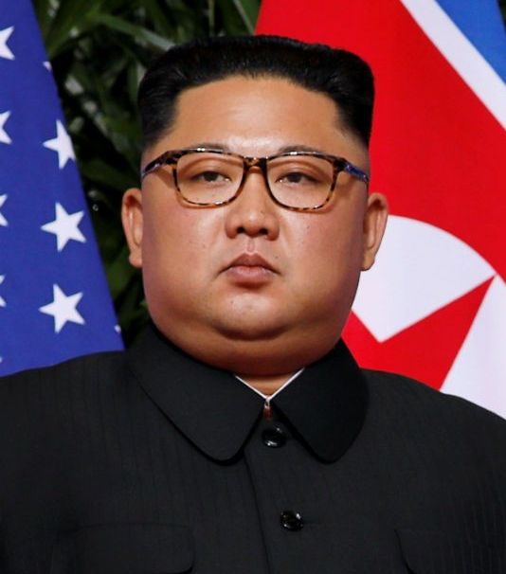
FACTOR PACK
Factor 8: Kim Jong-un takes control
2016: May – The ruling Workers Party holds its first congress in almost 40 years, during which Kim Jong-un is elected leader of the party, although he had been chairman of the party since 2012.
2016: November – UN Security Council further tightens sanctions by aiming to cut one of North Korea's main exports, coal, by 60%.
2017: January – Kim Jong-un says that North Korea is in the final stages of developing long-range guided missiles capable of carrying nuclear warheads.
2017: February – Kim Jong-un’s estranged half-brother Kim Jong-nam is killed by a highly toxic nerve agent in Malaysia, with investigators suspecting North Korean involvement.
Notes:
Image: US Government/Dan Scavino, https://commons.wikimedia.org/w/index.php?curid=70704984

Slide 17
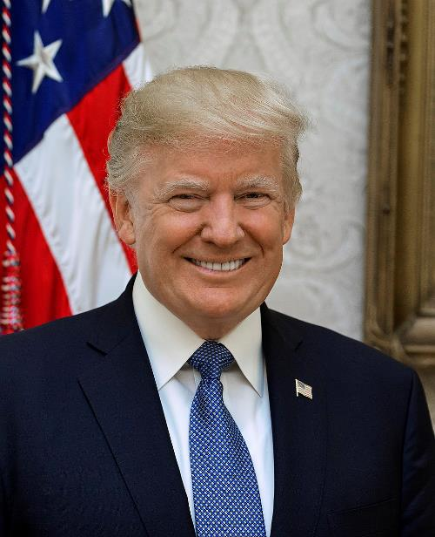
FACTOR PACK
Trump threatens ‘fire and fury’
2017: July – Pyongyang test-fires a long-range missile into the Sea of Japan, with some experts stating that the missile could potentially reach Alaska.
2017: August – Tension rises in war of words with USA over North Korean threat to fire ballistic missiles near US Pacific territory of Guam. Trump calls Kim ‘Rocket man’ and declares that his ‘button is bigger than Kim’s’.
China announces its plans to implement the UN sanctions against North Korea agreed earlier in the month, banning imports of coal, minerals and seafood.
Source 8A: Extract from an article in the American liberal newspaper The Washington Post
Trump persuaded China and Russia to impose some of the strongest sanctions ever imposed on North Korea. But even more importantly, according to Andrei Lankov, a professor at Kookmin University in Seoul, his talk of ‘fire and fury’ really rattled the regime.
Whether it was a bluff or not, Trump left the North Koreans believing he could consider military action against North Korea. And then he did what no other U.S. president had dared do: He opened the door to summit-level talks. Many analysts in North Korean affairs say Kim came to Singapore prepared to talk seriously about a deal, to reduce his nuclear arsenal in return for peace and a better relationship with the United States.
Notes:
Source 8A: www.washingtonpost.com/world/asia_pacific/how-trumps-north-korea-gambit-came-undone/2019/12/22/88091090-1afe-11ea-9ddd-3e0321c180e7_story.html
Image: US Government/White House/Shealah Craighead: https://commons.wikimedia.org/w/index.php?curid=63768460

Slide 18
FACTOR PACK
Factor 9: Moon’s new sunshine policy and summit diplomacy, 2018
Moon’s new sunshine policy
2018: January – First talks in two years between North and South Korea begin thaw that leads to the North sending a team to the Winter Olympics in the South.
2018: April – Kim Jong-un becomes first North Korean leader to enter the South when he meets South Korean President Moon Jae-in for talks at the Panmunjom border crossing. They agree to end hostile actions and work towards reducing nuclear arms on the Peninsula.
Source 9A: Comment by Robert Kelly, Korea analyst at the Lowy Institute. The Lowy Institute is an independent think tank that funds scholars to write articles on international affairs
‘The core argument of Moon’s détente effort – like that of his liberal predecessors from 1998­ to 2008 – is that North Korea will temper its behaviour, or even become a partner to South Korea, if we bring it in from the cold. So the traditional approaches of sanctions and containment favoured by the US, Japan, and the South Korean right are actually making the problem worse.​
The American relationship is hotly debated, as the US is often blamed for supporting repressive dictators in pre-democratic South Korea. And there is sneaking suspicion that the US military presence here manipulates South Korean foreign policy, a neo-colonial critique.’
Notes:
Washington Post article: www.washingtonpost.com/world/asia_pacific/how-trumps-north-korea-gambit-came-undone/2019/12/22/88091090-1afe-11ea-9ddd-3e0321c180e7_story.html
Dan Scavino: https://twitter.com/Scavino45/status/1006358006475427840
Robert E. Kelly, Korea analyst: www.lowyinstitute.org/the-interpreter/moon-jae-s-foreign-policy-reorientation

Slide 19
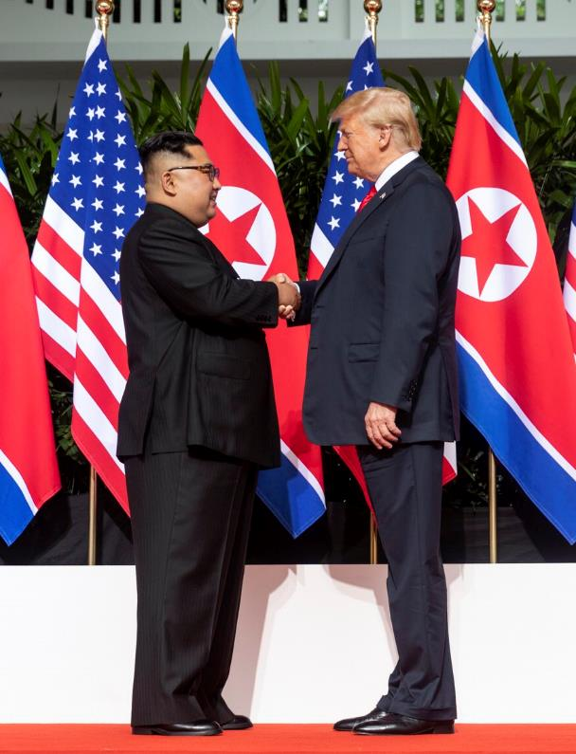
FACTOR PACK
Summit diplomacy 2018–19
2018: June – Kim Jong-un and US President Donald Trump’s historic meeting in Singapore seeks to end a tense decades-old nuclear stand-off.
2019: February – A follow-up meeting in Hanoi breaks down after North Korea refuses nuclear disarmament in return for lifting economic sanctions.
Source 9B: A report by the Bloomberg press agency, May 2019
Donald Trump and Kim Jong Un often explain their surprisingly warm relationship in the language of romance.
They ‘fell in love’ during the first-ever summit between a U.S. president and a North Korean leader in Singapore last year, Trump said.
A top North Korean diplomat similarly describes the chemistry between the two leaders as ‘mysteriously wonderful.’
Notes:
Image: US Government/White House/Shealah Craighead: https://commons.wikimedia.org/w/index.php?curid=69881197

Slide 20
FACTOR PACK
Source 9C: The liberal American newspaper The Washington Post, December 2019
Extract 1 Trump made at least two key mistakes in Singapore. First, he failed to get Kim to define what he meant by the ‘complete denuclearisation of the Korean Peninsula.’ Ever since, Washington and Pyongyang have talked at cross purposes. The U.S. side interpreted the phrase to mean unilateral North Korean denuclearization. The North Koreans insist it refers to the removal of U.S. ‘nuclear threats’ to their country before the removal of its deterrence.
Trump also pledged to end joint U.S.– South Korea joint exercises which he described as provocative and expensive ‘war games.’ It was a promise his military was not prepared to keep. Exercises were scaled back, but not stopped completely, to maintain a degree of combat readiness. North Korea says it feels ‘betrayed’ by this broken promise and no longer obliged to keep its promises.’
Extract 2 In Hanoi, Trump revealed an apparent lack of understanding about what really drives Kim. Trump has offered a ‘bright future’ for North Korea if only it would surrender its nuclear arsenal. The ‘big deal’ never interested the North Koreans. In effect, Pyongyang was being asked to surrender regime security in return for a vague promise of investment. That was never an attractive gamble for Kim.
But the biggest mistake in Hanoi might have been the way Trump snubbed Kim by cancelling lunch and ending the meeting early. It’s the sort of tactic that might work well when trying to close a real estate deal, but might not be so effective when dealing with a prideful and capricious dictator. The snub might have increased internal pressure on Kim to take a tougher stand, or might simply have damaged his pride. Either way, he appeared visibly upset after the summit, and relations have since nose-dived.
Source 9E: Olivia Enos, policy analyst, Asian Studies Center, The Heritage Foundation
President Trump made the right decision to walk away from a deal.
North Korea’s ask to remove all sanctions was untenable and also illegal. According to US and UN sanctions, sanctions cannot be removed until complete, verifiable, irreversible dismantlement of North Korea’s nuclear program takes place and the regime makes human rights improvements.
The 80,000 to 120,000 North Korean people inside those prisons camps are being exploited by Kim Jong-un as free labour to fund and architect his nuclear and missile weapons program.
Reports indicate that some may even have chemical and biological weapons tested on them.
Notes:
www.bbc.co.uk/news/world-asia-47382060

Slide 21
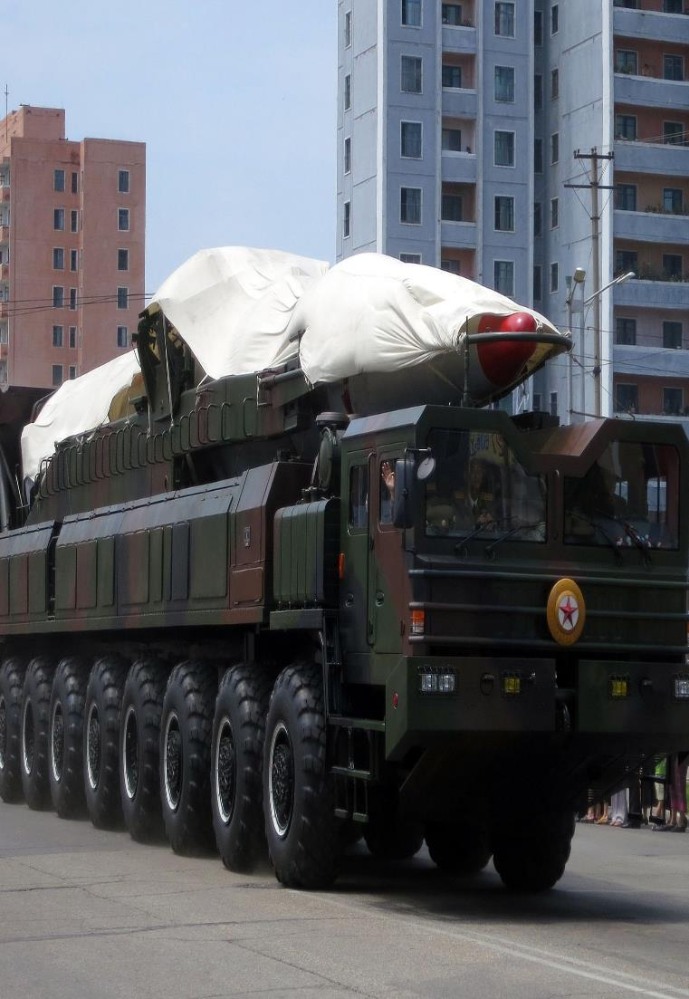
UN Security Council debate: North Korea nuclear missile test
Activity 2
The scenario is that North Korea has just tested a new nuclear weapon. Tensions on the Korean Peninsula have reached an all-time high.
You are a delegate representing a participant nation. Your role is to identify:
how you would seek de-nuclearisation
what your demands may be
what likely demands North Korea or other powers are likely to make
how you may respond to those demands
Notes:
Image: CC BY 2.0/Stefan Krasowski/Wikimedia, https://commons.wikimedia.org/w/index.php?curid=58241477

Slide 22
Plenary
Why has there been no peace in Korea?
What is the most effective path to peace?
Notes:
Image: © Author/Guy Birks

