Slide 1
Enquiry overview: The Glorious Glosters What happened at the Battle of the Imjin River, April 1951?
Enquiry 4:
Lesson 5.1
Use evidence to build a narrative of what happened at the Battle of the Imjin River
Lesson 5.2
Write an account of what happened at the Battle of the Imjin River

Slide 2
Lesson 5.2 Overview
Lesson 5.2
Write an account of what happened at the Battle of the Imjin River
Main features of this lesson:
(Rather than new content, this lesson is focusing on using what you learnt in the last lesson.)
Recap of the main events of the battle.
Selecting relevant information from sources to use in your narrative.
Comparing memorialisation of the battle in Britain and in South Korea.
Arguing for a new memorial to the battle.

Slide 3
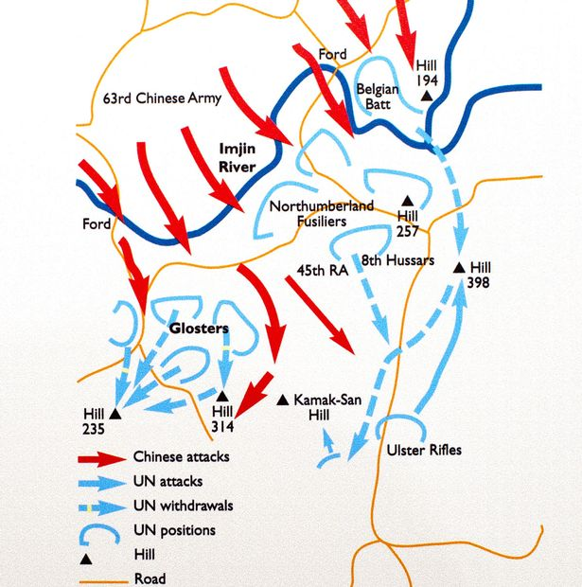
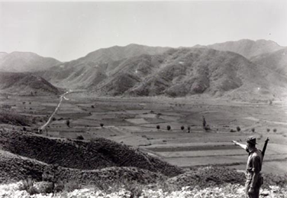
What happened at the Battle of the Imjin River?
Activity 1
Recap the main events of the battle from the last lesson
Notes:
Left: © IWM BF 10277, www.iwm.org.uk/collections/item/object/205190860
Right: Bristol Post www.bristolpost.co.uk/news/bristol-news/glorious-glosters-could-finally-identified-1907716

Slide 4
Write an account of the Battle of the Imjin River
Activity 2
Write an account of how UN forces were able to halt the Chinese Spring Offensive.
History is always controversial. But we can say that the Battle of the Imjin River saved Seoul from capture in 1951.
Your task is to explain this in an account. You have gathered lots of information from the sources. You now need to select the relevant information and turn it into a narrative.
Your narrative could feature one or more of these elements:
What the Chinese were trying to achieve
What the UNO forces were trying to achieve
Why the Imjin River area was important
The seriousness of the fighting
Any particularly important or interesting events in the battle
The end results of the battle
Writing frame available if needed (Resource sheet 5.2A)

Slide 5
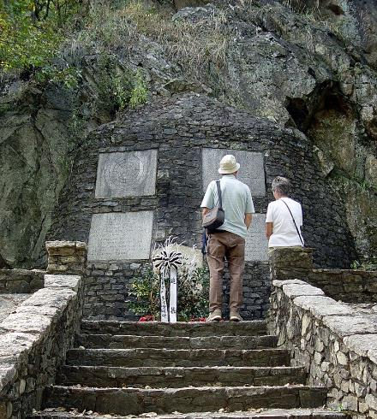
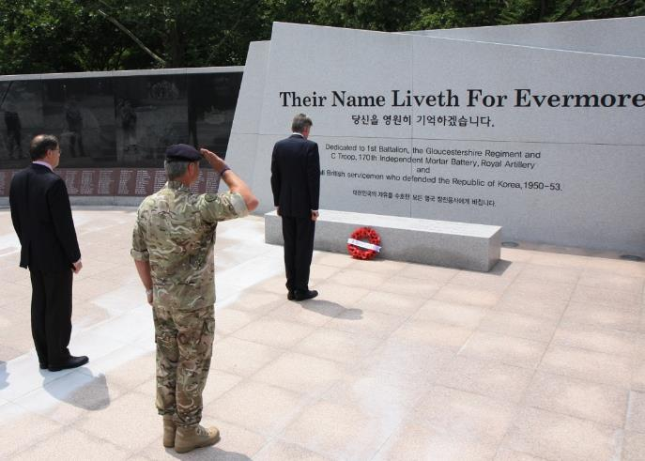
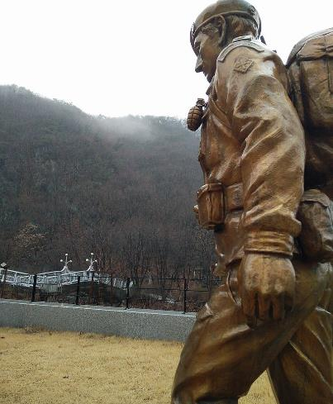
How the battle is remembered in South Korea
Activity 3
Compare how the Battle is commemorated in South Korea with the British memorials on the next slide.
Why might there be these differences?
The Gloucester Valley Battle Monument was built by the people of the ROK in South Korea.
The hill where the main battle took place has been renamed Gloster Hill.
Notes:
Left: Public domain/Jpbarrass/Wikimedia, https://commons.wikimedia.org/wiki/File:Gloster_Memorial_by_Seolmacheon.jpg
Centre: CC BY 2.0/OGL v1.0/Foreign and Commonwealth Office, https://www.flickr.com/photos/foreignoffice/20484854475/
Right: CC BY-SA 4.0/Stingray Trainer/Wikimedia, https://commons.wikimedia.org/wiki/File:Gloucester_Valley_Battle_Monument.jpg

Slide 6
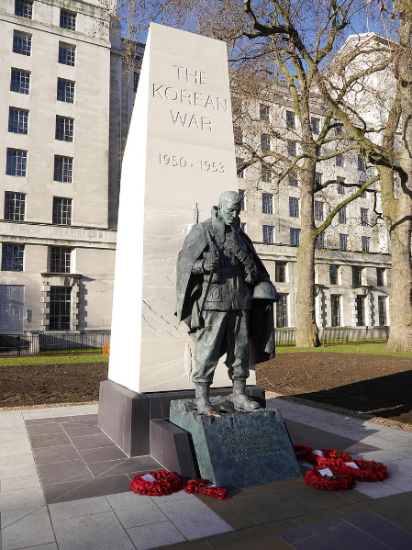
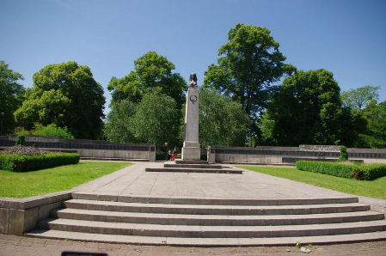
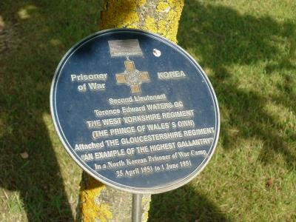
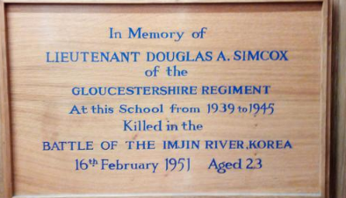
How the battle is remembered in Britain
There isn’t a monument to commemorate the Battle of the Imjin River in Britain.
Korean War memorials are often attached to monuments that recognise a range of conflicts.
There are general memorials such as those shown in A and B, and a range of small memorials that name local soldiers, such as those in C to D.
D. Lieutenant Simcox,
Bedford Modern School
A. This monument was erected in London in 2014
B. War Memorial, Gloucester
C. Lieutenant Waters,
National Memorial Arboretum
Notes:
A: CC BY-SA 4.0/Chris McKenna/Wikimedia, https://commons.wikimedia.org/wiki/File:Korean_War_Memorial,_London_2014-12-19_-_21.jpg
B: © Mark Newton (WMR-20766), https://www.iwm.org.uk/memorials/item/memorial/20766
C: © Jenny Turner (WMR-78700), https://www.iwm.org.uk/memorials/item/memorial/78700
D: © Alexander Smith (WMR-7641), https://www.iwm.org.uk/memorials/item/memorial/7641

Slide 7
Why is Imjin River remembered more creatively in Korea than in Britain?
Activity 3 (continued)
Which of these explanations do you most agree with?
A. South Korean people wanted to honour the Glosters for their role in saving the ROK from communism. | B. South Korea’s government is keen to remind Britain and other UN countries of their commitment to the ROK in case the North ever invades again.
C. The Korean War was largely forgotten in Britain because it was overshadowed by the Second World War, which finished only five years before. Korea did not have an impact on Britain at home like the Second World War did. | D. The Korean War has never been settled. For many years, it was overlooked, as it was a short conflict in a distant land. Unless you knew someone in the war, people did not know much about it.

Slide 8
Make the case for a better memorial
Activity 4
Come up with FOUR reasons why Britain should erect a better memorial for Imjin River.
A. | B.
C. | D.

Slide 9
Make the case for a better memorial
UK War Memorials is funded by the UK government and records, maintains and accepts applications for UK memorials. You can find their website here:
www.ukwarmemorials.org
They even have a ‘create a new memorial’ page with a help sheet:
www.ukwarmemorials.org/create-a-new-memorial
Activity 4 (continued)
Write a letter to the War Memorials Trust persuading them to create a monument to honour the Battle of the Imjin River.
Chose two or three of the following points to back up your case:
1. The importance of the battle to the war
2. Casualties
3. Bravery
4. Prisoners of war
Writing frame available if needed (Resource sheet 5.2B)

