Slide 1
Enquiry: How should the Korean War be remembered?
Lesson 3.1
Who was most deeply affected by the Korean War between 1950 and 1953?
Lesson 3.2
Why did some British military veterans forget the Korean War and deliberately remember it again years afterwards?
Lesson 3.3
Who should be remembered on our new memorial and how?

Slide 2
Lesson 3.3 Overview
Lesson 3.3
Who should be remembered on our new memorial and how?
Content covered in this lesson
Compare Korean War memorials from around the world
Decide who should be commemorated on your memorial
Design your new memorial and write an explanation of your design

Slide 3
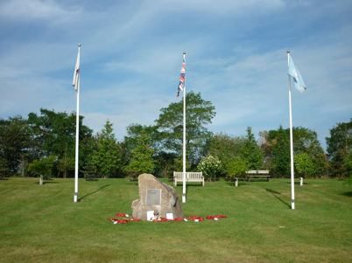
Korean Veterans Memorial, National Memorial Arboretum, Staffordshire, UK
Starter
Study the information about this memorial on the next slide.
Do you think this is a good memorial? Why?
Does this memorial do justice to the people and issues that we have been examining? Why?
Notes:
Korean Veterans Memorial, National Memorial Arboretum, Staffordshire, UK CC BY-NC 4.0 © Jenny Turner (WMR-51067)

Slide 4
Information about the memorial
The memorial includes four boulders, each representing one of the four years in which the British Armed Forces participated in the Korean War from 1950 to 1953.
Each boulder has a metal plaque on it, explaining what happened in each year.
There are three flags flying, those of Britain, South Korea and the United Nations.
Surrounding the memorial are 25 trees that typically grow in Korea.
The memorial was opened in 2000 by the Korean Veterans Association on the fiftieth anniversary of the outbreak of the Korean War in 1950.

Slide 5
Design a new Korean War memorial
Your commission
Suppose that the existing Korean Veterans Memorial is to be replaced but on the same site.
Your task is to design a new memorial that will be ready for opening in 2023 on the seventieth anniversary of the end of the Korean War.
You should be able to justify:
Who you have included or excluded from the memorial and why.
What materials, symbols, images and words you have included and why.
You can make more than one design if you wish to cover different options.

Slide 6
Learn from other Korean War memorials
Activity 1
Study the war memorials on Slides 7–16. Use these questions to guide you.
Which memorial most appeals to you and why?
Symbols:
What flags or symbols are visible? Why have they been included?
Words:
What words can you see? Why have they been chosen?
Location:
Where is the memorial? What kind of environment surrounds it?
Audience:
Who is meant to see it? Might someone be offended by it? If so, who and why?
People:
What human figures are shown? What are they doing? Who are they?
Materials:
What is the memorial made from (e.g. wood, stone, metal)?
Impact:
What overall impression does it give you?
Funding:
Who paid for it and why?
Note: You may not be able to answer all these questions about every memorial.
Date:
When was it made?

Slide 7
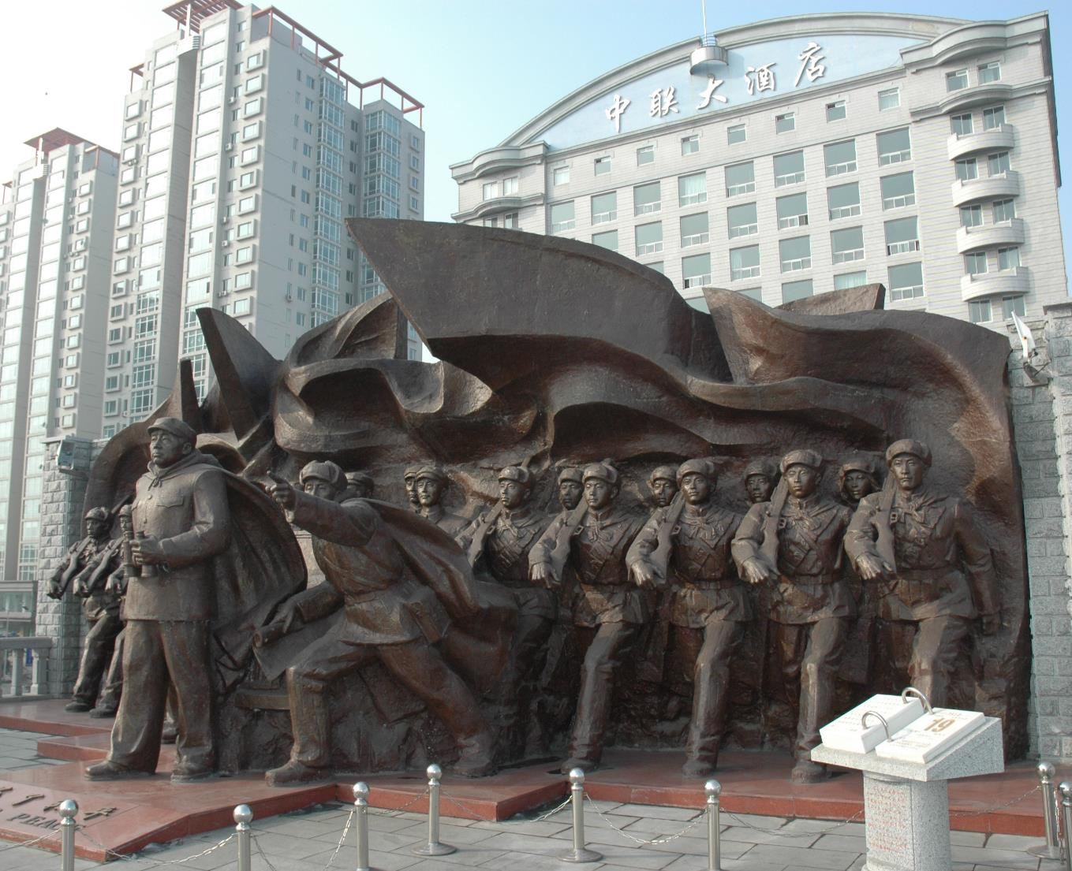
Part of a Chinese communist memorial to the Korean War
Notes:
Image: CC BY-SA 4.0/Ffggss /Wikimedia, https://commons.wikimedia.org/wiki/File:Sino-Korean_Friendship_Bridge08.jpg

Slide 8
Information: Chinese communist memorial to the Korean War
The memorial shows General Peng Dehuai leading Chinese soldiers across the Yalu River from the border city of Dandong in October 1950.
The soldiers were sent to help North Korea fight UN forces, who were close to the Chinese border and might threaten communist China itself. Chinese troops helped to push back the UN troops.
The soldiers were officially known as ‘volunteers, which avoided the Chinese government having to declare war against UN forces.
‘For Peace’ is written in English and Chinese at the foot of the statue. Chinese support for North Korea was meant to end the war and so bring peace to the whole of Korea.
The Chinese saved North Korea from defeat. In China, the Korean War is known as the ‘War to resist US aggression and aid Korea’.
The memorial forms part of a museum about Chinese involvement in the Korean War.
The museum was built in Dandong in the 1990s.

Slide 9
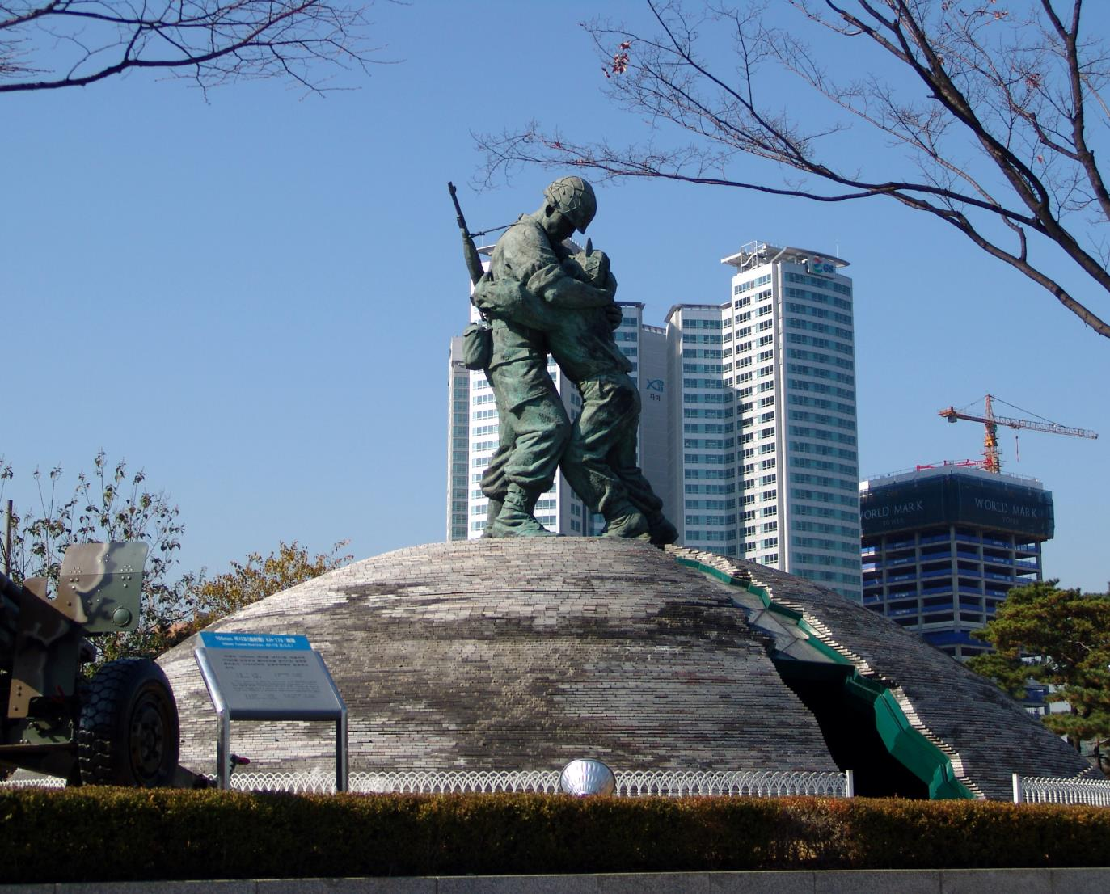
The Statue of Brothers in Seoul
Notes:
Image: CC BY-SA 3.0/Danleo/Wikipedia https://commons.wikimedia.org/wiki/File:The_Statue_of_Brothers_(Seoul_War_Memorial).jpg

Slide 10
Information: The Statue of Brothers war memorial in Seoul
The statue shows two Korean soldiers from the Korean War embracing across a split concrete dome.
The taller, well-armed soldier with a helmet represents a South Korean soldier reunited on a battlefield with his younger, unarmed smaller brother from the North Korean Army.
The split concrete dome represents a Korea still divided between two states.
The inside of the dome includes a floor map showing 16 allies from United Nations forces who assisted South Korea in its war with North Korea and communist China.
The memorial is intended to show the past sufferings of the Korean people and their determination to achieve national harmony, unity and prosperity.
The memorial was opened in 1994, after South Korea became a democracy in 1987.

Slide 11
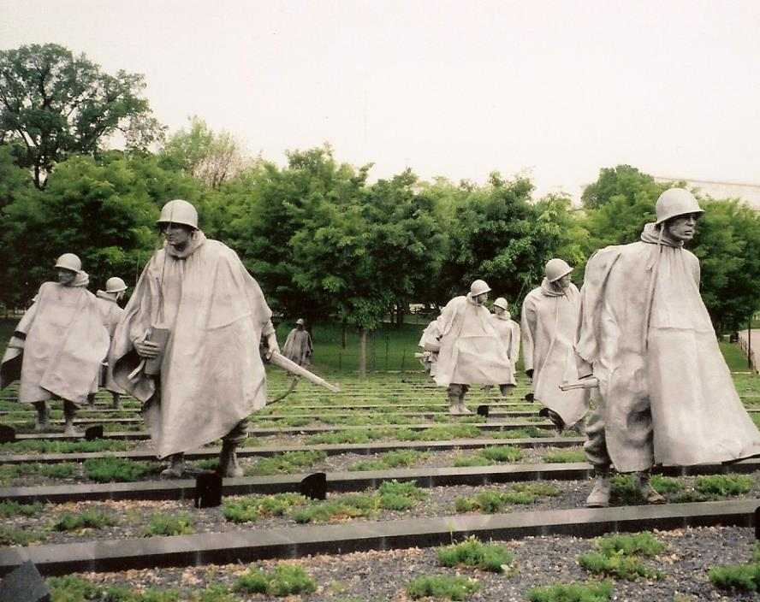
US Korean War Veterans Memorial, Washington DC
Notes:
Image: CC BY-SA 2.0/Ken Lund https://www.flickr.com/photos/kenlund/2521285707

Slide 12
Information: US Korean War Veterans Memorial, Washington DC
This memorial shows 19 larger-than-life stainless steel statues of members of the US Armed Forces in combat gear, warily crossing a field during the Korean War.
The ground is planted with low-lying juniper bushes to look like a Korean rice paddy field.
The statues deliberately include all the different ethnic groups who served in the American army, e.g. African-Americans, Native Americans, etc.
There are no statues of other nationalities or of South Korean civilians (although the countries who took part as US allies are listed on another part of the memorial).
The memorial was opened in 1995 by the US and South Korean presidents.
In 2015, Samsung, a South Korean company, paid money for the maintenance of the monument.

Slide 13
Korean War memorial in the port of Cartagena, Colombia, South America
Notes:
Image: CC0 1.0/Anfecaro/Wikimedia https://commons.wikimedia.org/wiki/File:Geobukseon_Colombia_Korean_War_Memorial.jpg

Slide 14
Information: Korean War Memorial in the port of Cartagena, Colombia, South America
The metal sculpture shows a sixteenth-century Korean ship called a Geobuksean (a turtle ship). This was used to defend the country against a Japanese invasion.
The ship stands on a stone platform, which includes a plaque and sculptures of cannons.
Two flagpoles come out of the ship flying the Colombian and South Korean flags.
The memorial is located in Cartagena because Colombian troops who were sent to support United Nations forces started their sea journey to Korea from Cartagena. Colombia was the only South American country to take part in the Korean War.
The memorial links how Korea resisted Japanese aggression in the sixteenth century with how Colombia helped South Korea to resist North Korean aggression in the twentieth century.
The memorial was paid for by the South Korean government and built in 2016.

Slide 15
Memorial at the Victorious Fatherland Liberation War Museum, Pyongyang, North Korea
Notes:
© Korea Konsult Part of the Victorious Fatherland Liberation War Museum, Pyongyang, North Korea http://www.koreakonsult.com/Attraction_Pyongyang_war_museum_eng.html

Slide 16
Information: Memorial at the Victorious Fatherland Liberation War Museum, Pyongyang, North Korea
This group of larger-than-life statues shows North Korean soldiers charging fiercely behind a North Korean flag.
In North Korean propaganda, the Korean War is referred to as a war of liberation to free South Korea from its puppet government and US occupation.
It is described as a victorious war, thanks to the brilliant leadership of Kim Il-sung, North Korea’s first communist dictator. At different times since the war, North Korea has sometimes mentioned Chinese military support, which helped it to survive, and sometimes claimed victory just for itself.
The museum was built on its present site in 1963.

Slide 17
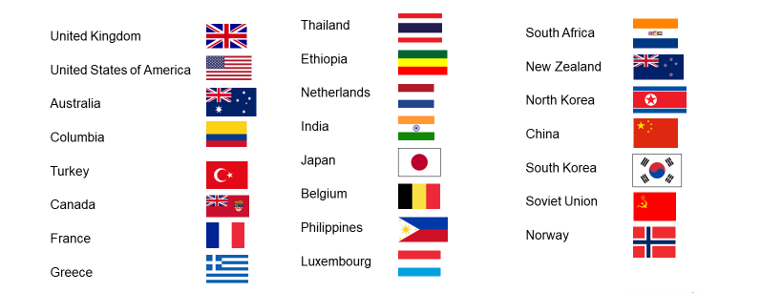
Who should be remembered? Decision 1
Activity
Decision 1 is: Just British or all UN casualties?
Here is a list of countries who suffered casualties in support of the UN forces.
Do you want to include all of these countries in your memorial? Why? Read the arguments for and against on the next slide before you make your decision.
How would it affect your design if you included all UN casualties?
Countries who suffered military casualties during the Korean War 1950–1953 as part of the UN force

Slide 18
Decision 1: Arguments on both sides
Arguments for:
It should include all United Nations casualties and veterans because…
South Korea today owes its freedom to all United Nations forces, not just British ones. The British only formed a small part of the United Nations forces.
UN soldiers who suffered or died deserve just as much recognition as British casualties and veterans.
Arguments against:
It should exclude all United Nations casualties and veterans because…
This is a British memorial, built on British soil and on ground set aside for the British Korean Veterans Association.
Remembering all United Nations casualties and veterans means that the site will stop being a special place of memory for the few surviving British Korean veterans and their families.
There are other memorials around the world that remember the casualties and veterans of other United Nations countries.

Slide 19
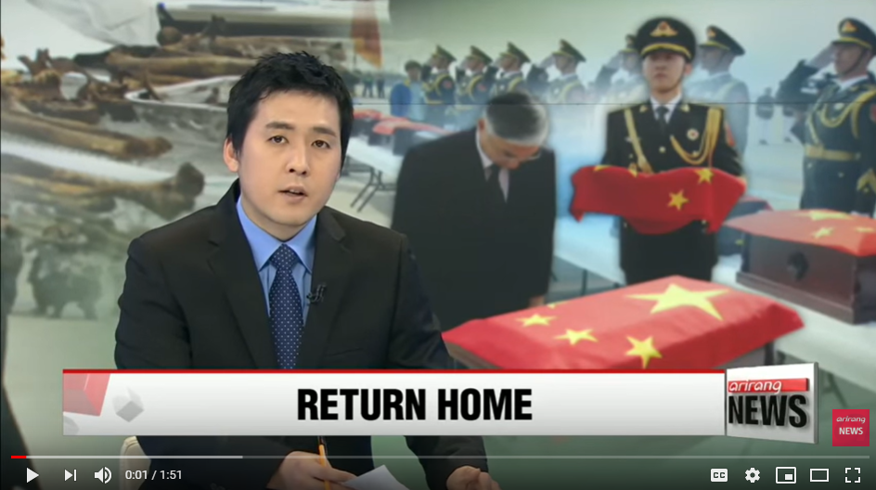
Who should be remembered? Decision 2
Activity
Decision 2 is: Should you also commemorate Chinese/Korean casualties?
Should Chinese and North Korean military casualties and veterans be included in your memorial? Read the arguments for and against on the next slide before you make your decision.
How would your design ideas have to change if you did commemorate North Korean, Chinese communist and Soviet military casualties and veterans as well?
Many Chinese and North Korean soldiers died in the Korean War while fighting in what is now South Korea. Their bodies were buried there in the South. In 2016 the bodily remains of some of these casualties were returned to North Korea. This video clip tells this story.
Notes:
Video: https://youtu.be/NDhq4-QEC_Q

Slide 20
Decision 2: Arguments on both sides
Arguments for:
It should include all military casualties and veterans because…
All those who served on both the United Nations and communist sides fought for a cause that they believed was just.
All war is wasteful and all the soldiers who took part deserve remembering.
Chinese, North Korean and Soviet troops fought as bravely (or as badly) as those of the United Nations.
Arguments against:
It should not include all military casualties and veterans because…
Those who fought on the side of North Korea, communist China and the Soviet Union were supporting North Korea’s aggression against South Korea.
It was their fault that Korea suffered so much between 1950 and 1953.
South Korea owes its freedom today to the United Nations – communist forces were the enemy.

Slide 21
Who should be remembered? Decision 3
Activity
Decision 3 is: Should all Korean civilian casualties be commemorated?
There were terrible civilian casualties from the Korean War. Some were killed by bombing or fighting. Many civilian casualties were the result of atrocities against their own citizens by both North and South Korean governments. Both regimes were ruthless dictatorships.
Should a new British Korean War memorial commemorate all the casualties of the war, whether civilian or military? Read the arguments for and against on the next slide before you make your decision.
How would your design ideas have to change if you did commemorate all Korean civilian casualties as well?
It is estimated that between 900,000 and 3 million Korean civilians died as a result of the war.
Millions lost their homes and were separated from their families.
Many were injured and suffered long after the war was over.
Few buildings from before the war were left standing, particularly in North Korea.

Slide 22
Decision 3: Arguments on both sides
Arguments for:
It should include all casualties, veterans and victims because…
The ordinary civilians of Korea suffered far more in the war than any other group of people, including veterans.
These civilians were often innocent victims of both sides.
All victims deserve the same respect as soldiers and veterans – leaving a group of people off a memorial is one way of saying that their suffering is unimportant.
Arguments against:
It should not include all casualties, veterans and victims because…
The memorial was built as a specific site of remembrance for veterans and their families – to change this would be disrespectful.
Korea itself is the best place for any memorials to the Korean victims of the war.
Different types of memorials are often built to remember different types of people who suffer in war – not everyone has to be included.
The memorial would put United Nations casualties and veterans on the same level as those who fought for the communist aggression that caused the Korean War in the first place.

Slide 23
How should they be remembered?
Your commission – a reminder
Your new memorial will be on the existing site of the Korean Veterans Memorial at the National Arboretum.
Your new memorial would be opened in 2023 on the seventieth anniversary of the end of the Korean War.
Your design can be a description or a drawing, or a 3-D model if you have time.
Write or record an explanation of your design. Make sure that you include:
Who you have included or excluded from the memorial and why.
What materials, symbols, images and words you have included and why.
Your audience: who do you want to see it?
You can make more than one design if you wish to cover different options.

Slide 24
Focus on…
In your design, focus on these aspects:
People:
Should it show people and, if so, what kind of people and how should they be represented? Realistic, like statues, symbolic or abstract?
Symbols:
Such as flags or icons?
Materials:
What will it be made of so that it lasts/matures over time?
Words:
Quotes from veterans, inspirational texts, religious texts, names of the dead, statistics, information about the war?

Slide 25
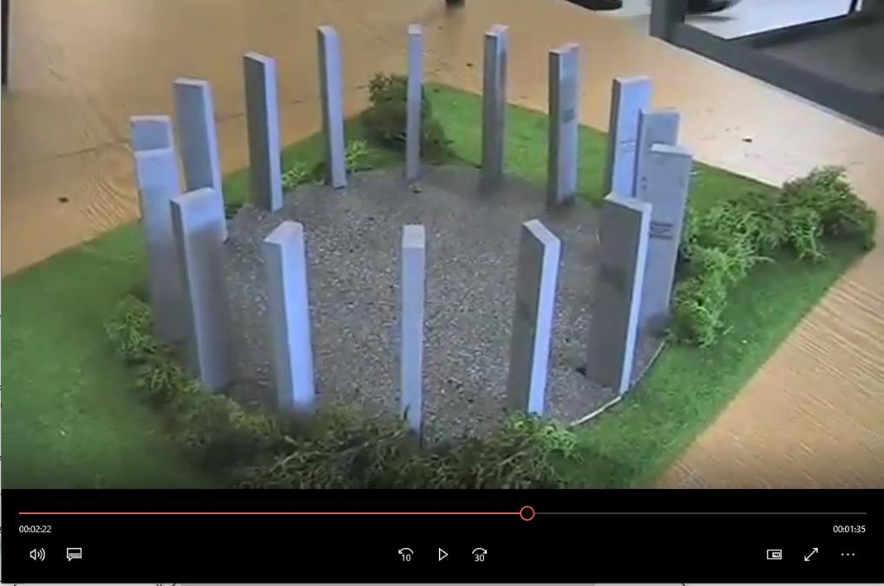
Here’s one I made earlier!
In this video, Felix from Cottenham Village College explains the design that he came up with for his new Korean War memorial.
Notes:
https://www.history.org.uk/library/2006/0000/0286/koreanwarprojectfilmFelix.mp4

Slide 26
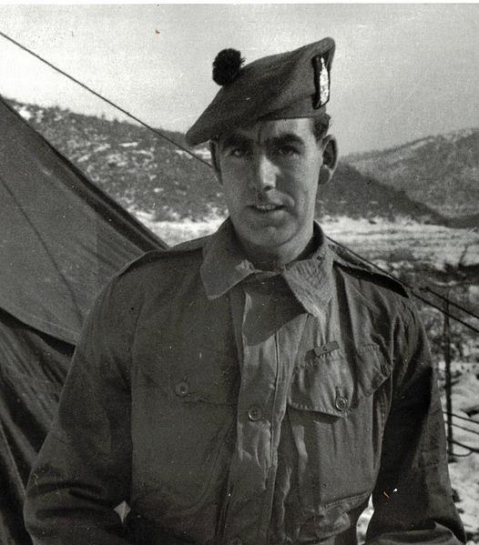
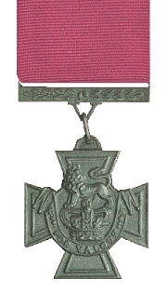
Plenary
What might Bill Speakman VC think of your new memorial designs?

