Slide 1
Were Medieval People very different from us?
Medieval
Lives
Mattered
See also PDF ‘Were medieval people very different from us?’

Slide 2
Feelings and Emotions
1. Tick TWO boxes that contain the feelings and emotions you most associate with people who lived in the Middle Ages
2. Put a cross in ANY boxes that contain feelings and emotions you do NOT associate with people who lived in the Middle Ages
A. Grief and Sorrow | B. Love, loyalty or friendship | C. Honour or pride
D. Anger or hatred | E. Selfishness and greed | F. Fear
G. Kindness, generosity, worrying about other people | H. Enjoyment, happiness, having fun | I. Morality – a sense of being right and wrong. Being merciful

Slide 3
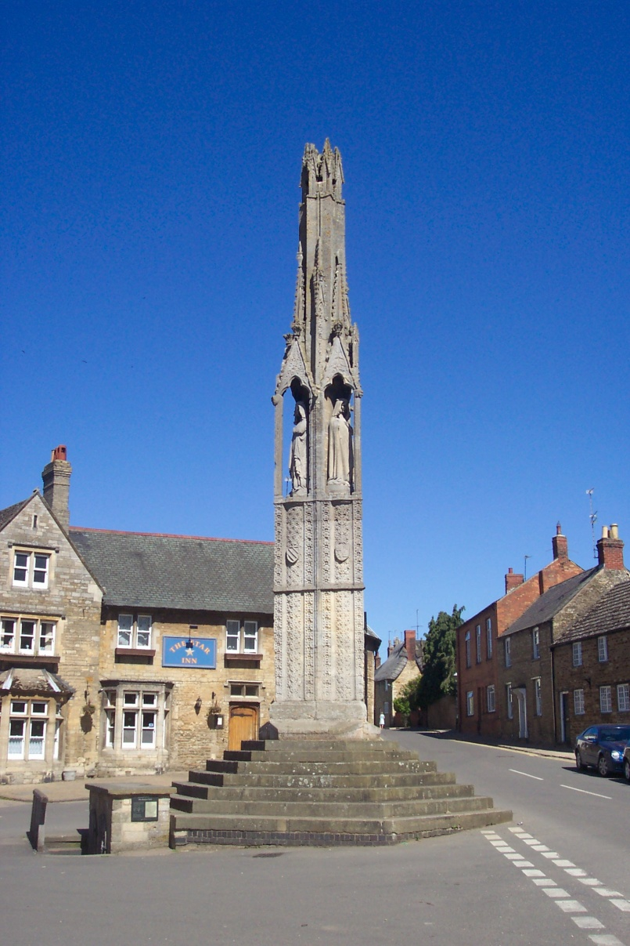
Eleanor’s Crosses
One of the 12 Eleanor Crosses built on the orders of Edward I after the death of his wife, Eleanor. The crosses were built at the places where her body spent the night on the way to Westminster for burial.
By Lofty at English Wikipedia, CC BY 2.5,
https://commons.wikimedia.org/w/index.php?curid=6078246

Slide 4
The Italian writer, Petrarch, wrote this letter to a friend in 1350 after the outbreak of the plague known as the Black Death:
“Where are our dear friends now? Where are the beloved faces? Where are the affectionate words, the relaxed and enjoyable conversations? What lightning bolt devoured them? What earthquake toppled them? There was crowd of us, now we are almost alone. We should make new friends, but how, when the human race is almost wiped out; and why, when it looks to me as if the end of the world is at hand?

Slide 5
 | Similarities between the Middle Ages and today | Differences between the Middle Ages and today
Emotions and Feelings
Everyday Life: If you’d been 12 in the Middle Ages
Did medieval people love their children?

Slide 6
Completely different from today
Mostly different
Slightly different
Completely the same as today
Emotions and feelings
Everyday life
Parents and
children

Slide 7
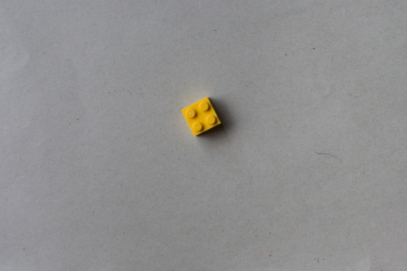
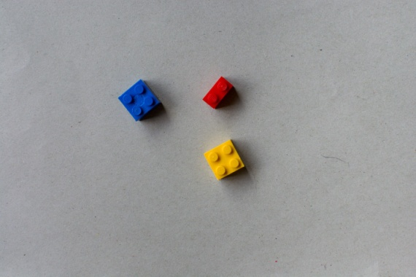
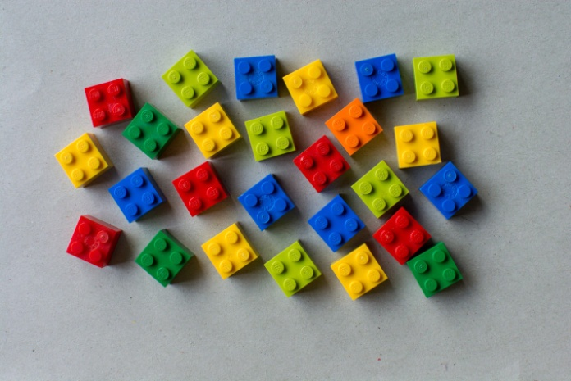
Changes in Population
Population in 1100
One brick = 2 million people
Population in 1300
Population in 1500
But after the Black Death in 1348 the population total fell back to the total in 1100
Population in 2000

Slide 8
‘It is often assumed that people of this period were vastly different from us. This is not a helpful assumption. Then, as now, individuals aimed to live the best lives possible while struggling to make ends meet …. [and] displaying emotions familiar to us: loyalty, jealousy, greed, hope, and passionate love.’
Professor Miri Rubin,
The Middle Ages: A very Short Introduction

