Slide 1
HA Resource Hub Submission Form
Resource Title: What caused the Slave trade? (Easier version) | Age Range: Year 8/ Ks3
Author name and email contact: Ruth Lingard r.lingard@millthorpeschool.co.uk | Resource Details: Power point with links
Necessary prior learning to complete this: This is the first lesson on the slave trade. | What does it lead to next? Students will look at the experiences of enslaved people and the abolition of the slave trade.
Explanation: How should this resource be used? I have kept the lesson very simple to suit home learning Task 1: Students watch an introduction to the slave trade and copy an introduction into their books. Task 2: Students watch an infographic showing the pace and scale of the slave trade. This macro highlights that many countries were involved and that South America and North America were also destination points. Students consider: Where are the ships going to and from? (You might need the map in your planner to work this out) When does the trade begin to pick up speed? When is the peak of the slave trade? When does it finish completely? Are you surprised by the scale of the trade and the number of countries involved? Does anything else surprise you? Task 3: Students explore 5 causes for the slave trade: sugar, cotton, tobacco, profits, the plantation system and test their recall using the picture clues Task 4: Students make a detailed causal mind map Task 5: ( I have borrowed this activity from SHP Year 8 History text book so all credits should go them) Students consider the individuals who benefitted from the slave trade. Task 6 and 7: Complete the diagram, deciding who benefitted the most. Task 8: Create a test using the knowledge organiser

Slide 2
What caused Britain to start to trade in people?
Click on the title above to watch a video introduction to the slave trade. We will be exploring many aspects of this shocking trade in the next few lessons.

Slide 3
Task 1. Write the title :
What caused Britain to start to trade in people?
Copy the introduction below into your books.
Slavery has existed throughout History. The Egyptians, the Romans, the Aztecs all had slaves. From the 17th century to the 19th century Britain also began a trade in African slaves. Why?

Slide 4
Watch this graphic. CLICK HERE. It charts the rise and fall of the British slave trade by tracking the slave ships that crossed the Atlantic. The graphic lasts for 2 minutes.
Task 2. As you watch consider:
Where are the ships going to and from? (You might need the map in your planner to work this out)
When does the trade begin to pick up speed?
When is the peak of the slave trade? When does it finish completely?
Are you surprised by the scale of the trade and the number of countries involved? Does anything else surprise you?

Slide 5
We are now going to look at 5 reasons (or causes) why this trade in enslaved people started.

Slide 6
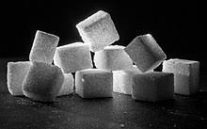
Cause 1: Sugar!
The 18th century British loved Sugar. It sweetened the new fashionable drinks of coffee and tea. It was also very expensive. Demand for sugar was going up. Sugar grew well in the plantations of the West Indies. Plantation owners were becoming very rich from this sugar trade but they needed slave labour to grow and tend the cane.
Notes:
https://en.wikipedia.org/wiki/Sugar#/media/File:W%C3%BCrfelzucker_--_2018_--_3564.jpg

Slide 7
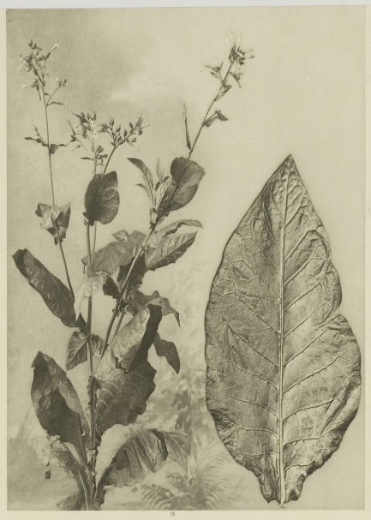
Cause 2:Tobacco
Explorers brought back tobacco from America. Like sugar it made huge profits when sold in Britain but needed to be grown on plantations in America by slave labourers.
Notes:
By Kleingrothe, C.J. (Kleingrothe, Carl Josef, 1864-1925) / Medan - Leiden University Library, KITLV, image 26868 Collection page Southeast Asian & Caribbean Images (KITLV), Public Domain, https://commons.wikimedia.org/w/index.php?curid=48358004

Slide 8
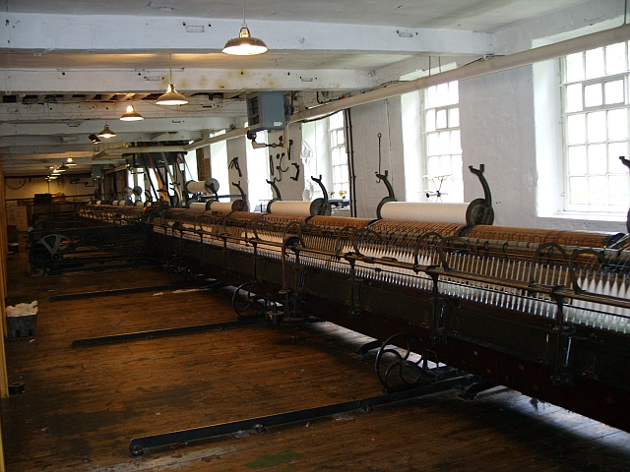
Cause 3:
Cotton was the new fashionable material. Cotton was grown in the America, again on big plantations that needed slave labour. The new textile mills needed cotton to weave into material. The material they made was then sold back to Africa and the West Indies.
Notes:
By Black Stripe at English Wikipedia, CC BY-SA 3.0, https://commons.wikimedia.org/w/index.php?curid=6033729

Slide 9
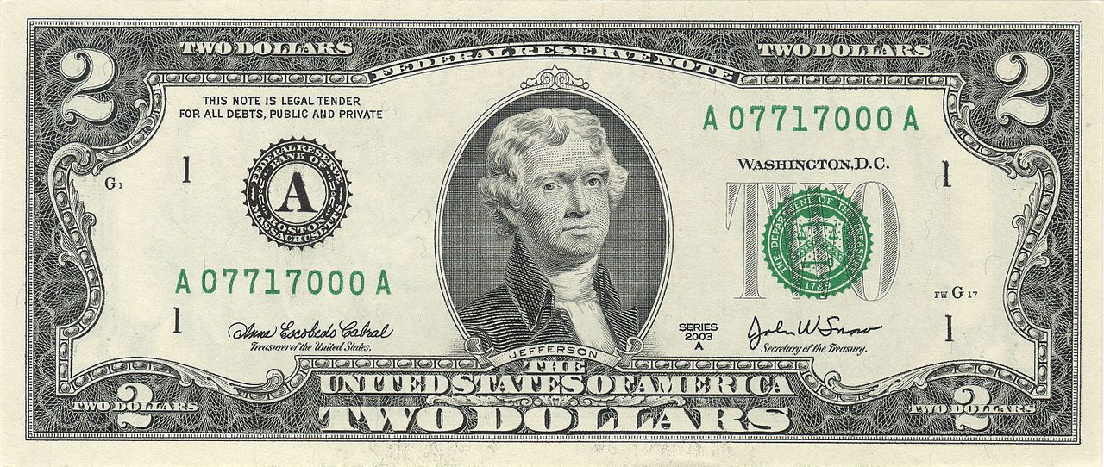
Cause 4:
British people owned the slave ships. This made them very rich.
Notes:
https://en.wikipedia.org/wiki/Dollar#/media/File:US_$2_bill_obverse_series_2003_A.jpg

Slide 10
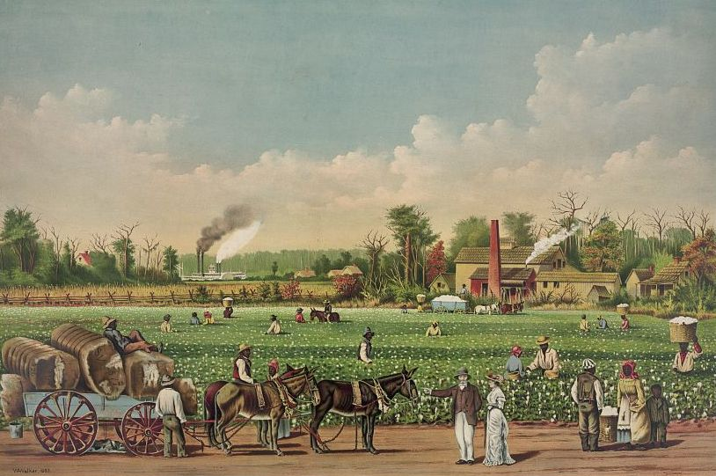
Cause 5: The Plantation System
Plantations were large farms that grew only one crop such as sugar, tobacco and cotton. They needed lots of workers. White Europeans began to buy enslaved African people. They were brought across the Atlantic and sold as slave labour. Many spent the rest of their lives being forced to work on the plantations. Plantation owners paid the enslaved people no wages and became very rich.
Notes:
https://en.wikipedia.org/wiki/Plantation_complexes_in_the_Southern_United_States#/media/File:Cotton_plantation_on_the_Mississippi,_1884_(cropped).jpg

Slide 11
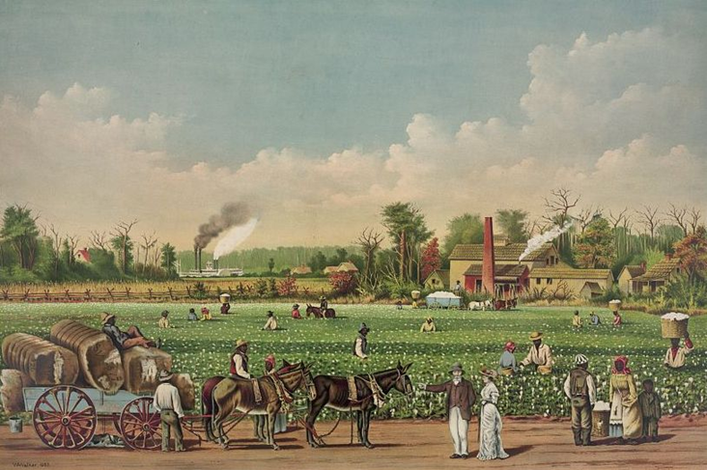
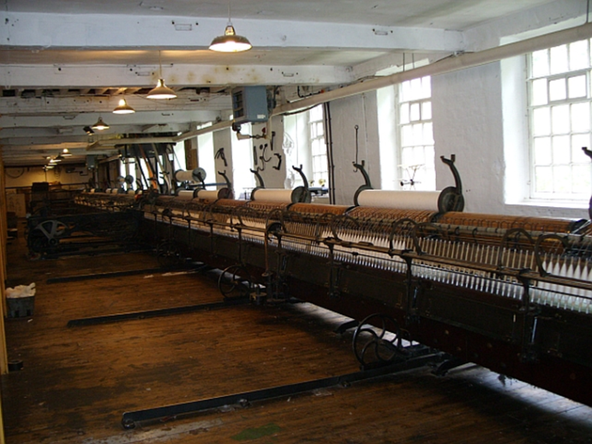
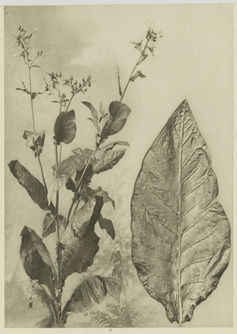


Task 3: Can you remember how each picture is a CAUSE of the slave trade? Test yourself.
What caused the British to begin the trans-Atlantic slave trade?

Slide 12
Task 4: Make a detailed a mind map over a double page (use the previous slides for information).
What caused the British to begin the trans-Atlantic slave trade?

Slide 13
Task 5. Read about the individuals who benefitted from the slave trade:
Ordinary people for whom the slave trade provided many jobs in Britain: half of Liverpool’s sailors were involved in the slave trade, there were the jobs in the factories making things to sell in Africa.
African war lords who captured other Africans and sold them as slaves to Europeans.
British slave traders who bought and sold slaves
British slave ship owners who made up 50% profits on some voyages.
The Factory Owners in Britain who had a market for their goods. Half of all textiles made in Manchester were sold in Africa and the West Indies
Plantation owners who used slaves to grow their crop. They paid no wages and provided only basic food and simple huts for the slaves to live in. All children of slaves became slaves as well.

Slide 14
Task 6 :
Why did lots of people need the slave trade?
Lots of people in Britain needed the slave trade because their jobs relied on it. For example : ……………………………………………………
{ Look back at the last slide and write down three examples of people whose jobs were linked to the slave trade}
TASK 7: THINK! Does this mean that everyone in Britain thought the slave trade was a good thing? Write your answer.

Slide 15
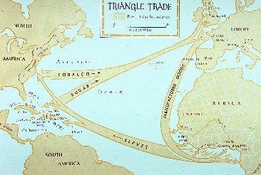
Appendix: Knowledge Organiser: Empire and Slavery
In 1492 Columbus discovered the Americas. This new World opened up new places to explore and lands to settle. From the early 1600’s England began to settle the
Caribbean. Between 1600 and 1900 Britain’s empire continued to expand. This was driven by a desire for:
New materials such as sugar, tobacco and cotton
New markets to sell their manufactured goods too
A desire for world power and profits
What was Africa like? Africa was a huge country split up into many different kingdoms. Some parts of Africa had organised governments, lots of international trade and schools: for example the Kingdom of Benin. Other parts of Africa were undeveloped and people lived very simple lives.
Why did the Slave trade increase? From the late 15th century European countries began to develop colonies, especially in the newly discovered lands of America. The Native Americans were nearly wiped out by European diseases, so settlers wanted to bring in workers who was immune to these illnesses. The answer, they thought, was to bring in enslaved Africans to do the work of clearing the land and farming the newly formed plantations
The Slave trade Triangular trade allowed European ships to sail down to Africa with holds full of manufactured goods such as fabric and guns. They then traded these for African slaves. The African slaves were chained below deck for the journey across the Atlantic. When they arrived they were sold at Auction and were taken to North America, South America and the Caribbean. The ship was cleaned out and filled with tobacco, cotton and sugar. It then sailed back to the ports in Europe. This was known as triangular trade.
Life on the plantation Slaves worked for no pay but they were given food and shelter. They worked in gangs, hoeing the soil, digging drains and harvesting crops. Some slaves worked in the master’s house as servants. Overseers kept order and were allowed to whip and punish the slaves if they disobeyed instructions. Many slaves tried to run away. By the end of the 18th century there were groups of people who were protesting that slavery was not morally right and should be ended. These people were called Abolitionists.
Why was it so difficult to end slavery? Slavery made lots of money for ship owners in England. Many M.P.’s also owned slave plantations and had made themselves rich from the trade. Many other workers also benefitted-e.g. the factory workers who used the raw cotton to make fabric. Half of Liverpool’s sailors were employed by the slave trade.
Who was responsible for ending the slave trade?
Thomas Clarkson travelled over 35,000 miles collecting evidence of the cruel treatment in the slave trade. William Wilberforce was an M.P. for Hull. He campaigned to end the slave trade. He used Clarkson’s evidence to try to persuade M.P.’s to make the slave trade illegal. In 1807 he succeeded in having the slave trade abolished although it was still legal to own existing slaves. Other individuals continued to campaign: Olaudah Equiano and Mary Prince, both former slaves had their autobiographies published. Religious groups such as the Quakers and the Methodists spoke out against slavery. In 1833 Slavery was abolished in the British Empire.
“..the enslaved themselves.. created their own strategies of resistance. In time, their defiance was to prove the crucial final factor in bringing down slavery itself.‘”James Walvin, Historian
Key words:
Abolitionist: a person who campaigned to end slavery
Trade triangle: the system in which a profit was made on every leg of the journey
Manufactured goods: Goods that have been produced in a factory
Raw materials: Natural products that will be manufactured e.g. Cotton
Plantations: Huge farms which grew only one crop e.g. Sugar

